Slide 1
Software Quality
Some Materials Based on Prof. Prem Devanbu

Slide 2
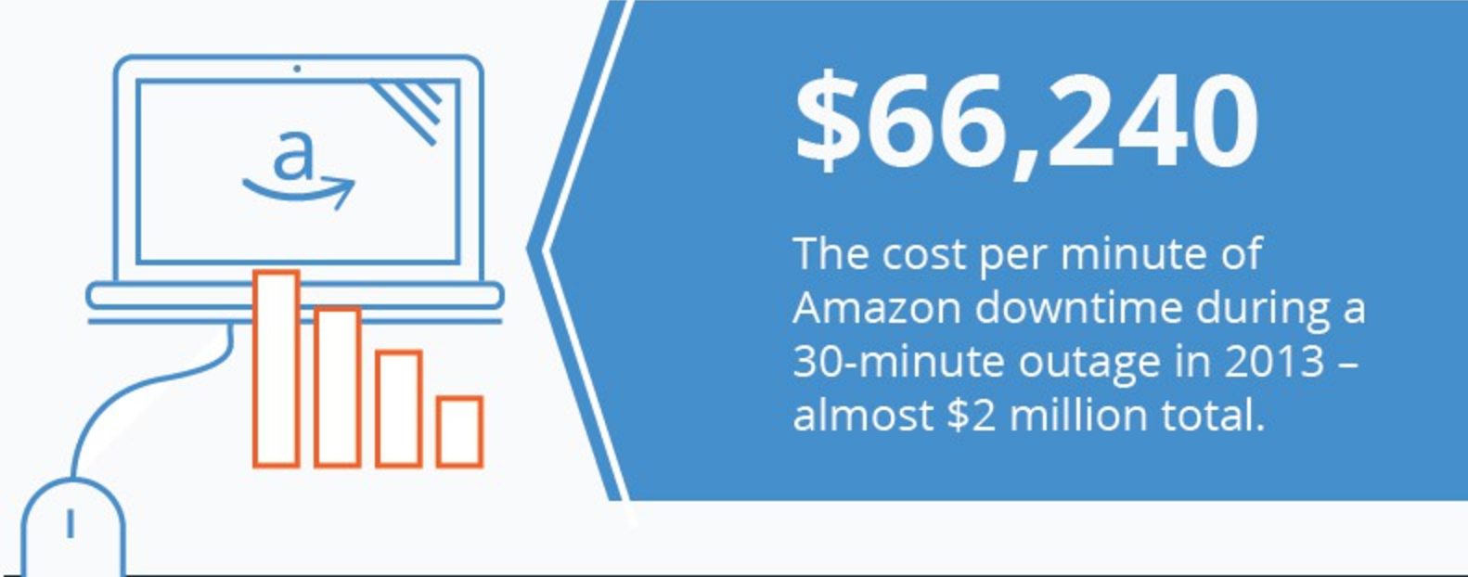
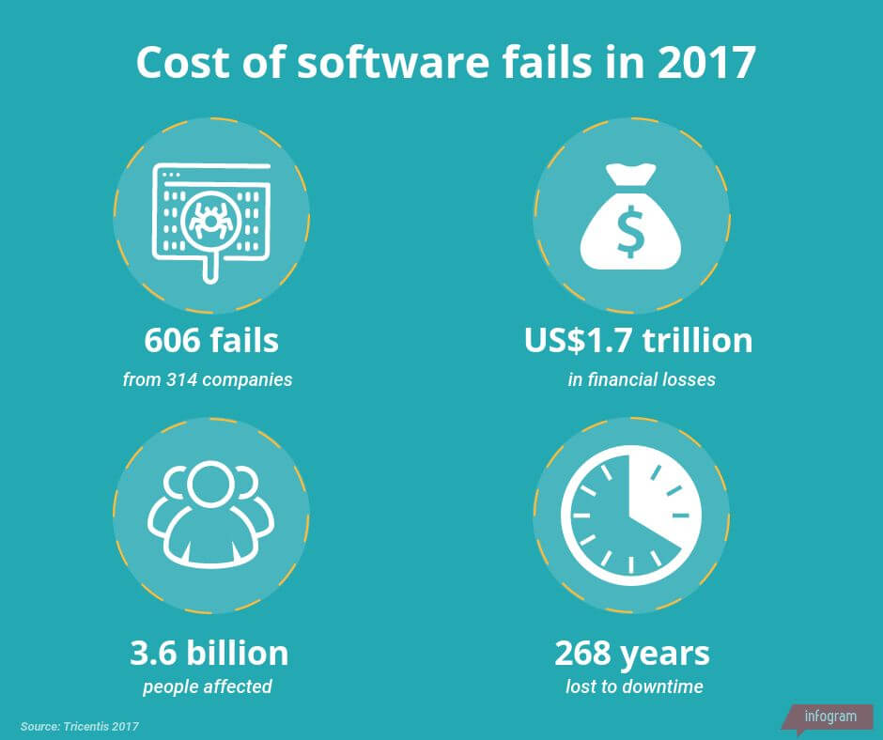
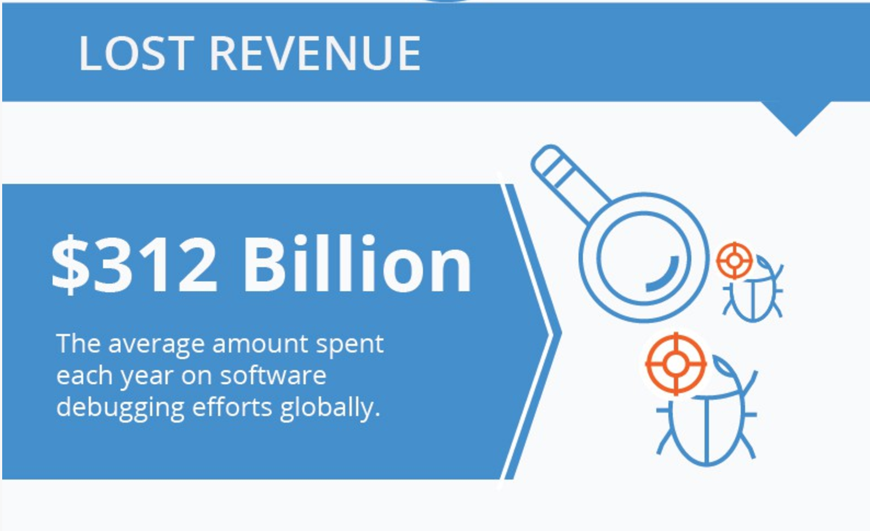
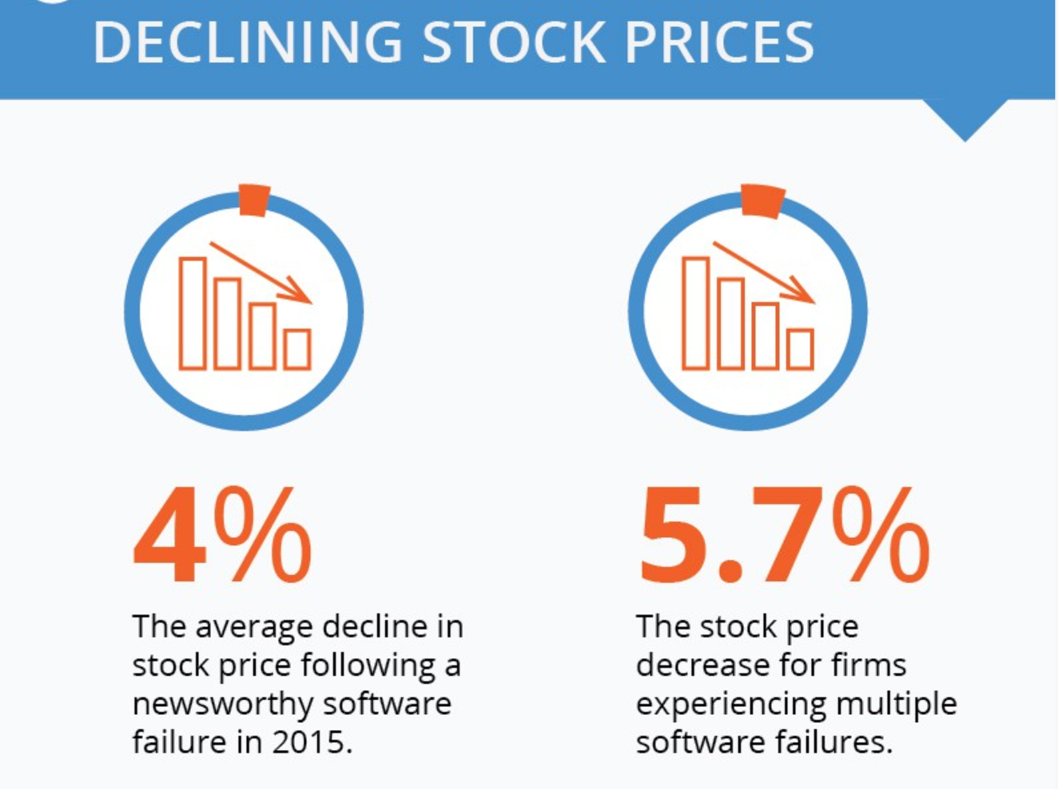
Cost of Software Failure
Source: https://raygun.com/blog/cost-of-software-errors/
Source: QASymphony.
Notes:
In a report on software fails, tricentis.com found that in 2017, software failures cost the economy US$1.7 trillion in financial losses. (Up from US$1.1 trillion in 2016.) In total, software failures at 314 companies affected 3.6 billion people and caused more than 268 years in downtime.

Slide 3
Ways to find Defects
Testing
Static & Dynamic Analysis
Code Reviews (Thursday)
Notes:
How well does each work?

Slide 4
Software Testing

Slide 5
What is software testing?
The process of evaluating a program or a system
Verifying that the product is right
Validating that the right product is developed
Evaluate quality
Find defects

Slide 6
Definitions
Failure is an event of failed function during operation
Fault/ Defect / Bug refers to an anomaly in a software
Error is an erroneous state of the software
Relationship
Failure caused by error
Error caused by a fault
Fault caused by a human error
Human error caused by engineer
Debugging / Fault localization – localizing, repairing, retesting

Slide 7
Definitions (cont)
A test case consists of:
A set of inputs
Testing steps
Expected outputs
(Execution conditions)
Additional attributes:
Purpose
Scope
Origin
Priority
…
Test oracle problem
Determining the correct output for a given input (and a set of program/system states)
In many cases it is very hard to find an oracle
Even the customer and end user might not be able to tell which is the correct behavior
E.g. autonomous control software

Slide 8
Test Case Construction/Design: Why?
Exhaustive testing (use of all possible inputs and conditions) is impractical
Need processes that help us selecting test cases
Effective testing – detect more faults
Efficient testing – detect faults with less effort

Slide 9
Sources for test case construction
Specifications (requirements, functional)
Source code
Input and output domains
Operational profile (usage)
Fault models
Techniques for test case construction
Control flow testing
Data flow testing
Domain testing
Functional program testing
White box
Black box

Slide 10
Black-Box vs. White-Box
External/user view:
Internal/developer view:
– Check conformance with specification (=verification)
– Allows tester to be confident about test coverage
Abstraction from details:
– Source code not needed
Scales up:
Based on control or data flow:
– Easier debugging
Does not scale up:
– Different techniques at different levels of granularity
– Mostly applicable at unit and integration testing levels
USE BOTH!

Slide 11


Black-Box vs. White-Box
System
Specification
Implementation
Missing functionality:
Unexpected functionality: Cannot be revealed by black-box techniques
Cannot be revealed by white- box techniques

Slide 12
Types of Testing
Level of detail
acceptance
system integration
- When? Test scheduling
- How? Automated vs. manual
-
-
What? New vs. regression test
unit
Whom? Test organization
portability
Accessibility
maintainability
white box
black box
efficiency
usability
reliability
functionality
Characteristics

Slide 13
Software Testing
- Whitebox Testing

Slide 14
Whitebox Testing
Exhaustive Testing
There are many possible paths!
5²⁰ (~10¹⁴ ) different paths
Selective Testing
Path selection criteria
All paths
Statement coverage
Branch coverage
Method coverage…

Slide 15
Code Coverage Measures
Code Coverage measure:
Any test T, any criterion, how good is it (% of code coverage).
Statement Coverage (CV_{s}):
Portion of the statements tested by at least one test case.
Branch Coverage:
Tests cover each decision element in the code with all possible outcomes
Decision elements: If-then, Case, Loop
Method Coverage:
Tests cover each method.

Slide 16
Life Insurance Example
bool AccClient(agetype age; gndrtype gender)
bool accept;
if (gender=female)
accept := age < 85;
else
accept := age < 80;
return accept;

Slide 17
All path coverage
Conditions
Control graph
Female | Age < 85 | Age < 80
Yes | Yes | Yes
Yes | Yes | No
Yes | No | Yes
Yes | No | No
No | Yes | Yes
No | Yes | No
No | No | Yes
No | No | No
<Yes,Yes,*> 1-2(T)-3(T)-5-7
<Yes,No,No> 1-2(T)-3(F)-6-7
<No,Yes,Yes> 1-2(F)-4(T)-5-7
<No,*,No> 1-2(F)-4(F)-6-7

Slide 18

Statement Coverage
Age, Gender
1
2
T
if(female)
F
bool AccClient(agetype age; gndrtype gender)
bool accept;
if (gender=female)
accept := age < 85;
else
accept := age < 80;
return accept;
3
Age <85
T
F
4
Age <80
T
F
5
6
Accept = true
Accept = false
7
Return accept
1-2(T)-3(T)-5-7 AccClient(83, female)->accept
1-2(F)-4(F)-6-7 AccClient(83, male) ->reject

Slide 19

Branch Coverage = Statement Coverage+
Age, Gender
1
2
bool AccClient(agetype age; gndrtype gender)
bool accept;
if (gender=female)
accept := age < 85;
else
accept := age < 80;
return accept;
T
if(female)
F
3
Age <85
T
F
4
Age <80
T
F
5
6
Accept = true
Accept = false
7
Return accept
1-2(T)-3(T)-5-7 AccClient(83, female)->accept
1-2(T)-3(T)-6-7 AccClient(88, female)->reject
1-2(F)-4(F)-5-7 AccClient(78, male) ->accept
1-2(F)-4(F)-6-7 AccClient(83, male) ->reject

Slide 20
Activity
Consider the following piece of code. What would be the Whitebox test cases to cover all paths?
Printme (int a, int b) { // Printme is a function
int result = a+ b;
If (result> 0)
Print ("Positive", result)
Else
Print ("Negative", result)
} // End of the source code

Slide 21
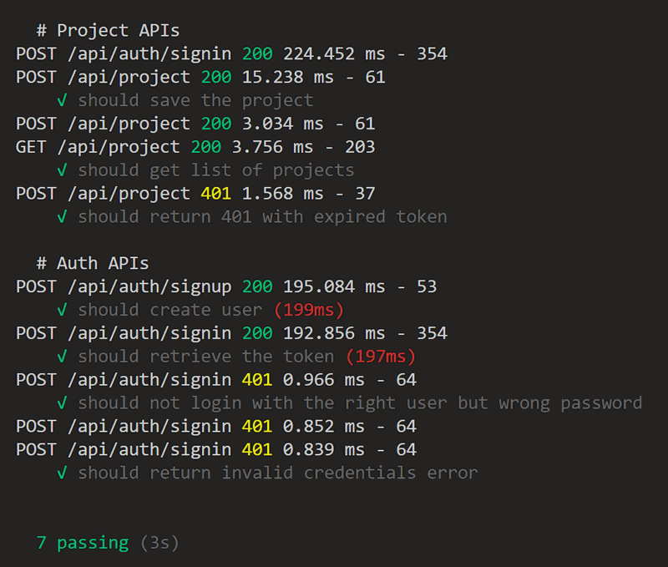
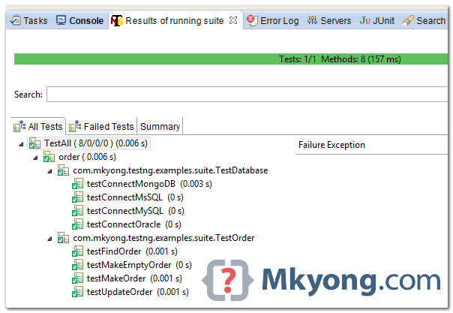
Unit Testing Frameworks
Mocha – See HW4-test directory
Junit -- (If you haven’t used it, download and try).
Notes:
A test framework is software that defines and provides several things:
Test API, which specifies how to write test code.
Test discovery, to determine which JavaScript files are test code.
The test lifecycle, which defines what happens before, during, and after a test is run.
Test reporting, to log what happened when the tests were run.
Mocha test APIs
describe() denotes an arbitrarily nested grouping of test cases (a describe() can contain other describe()s).
it() denotes a single test case.
Both functions take two arguments:
A description that appears in the test report
A callback function

Slide 22
Unit Testing with Mocha + Chai
Mocha: A test framework software that defines and provides several things:
A test API, which specifies how to write test code.
describe() denotes an arbitrarily nested grouping of test cases (a describe() can contain other describe()s).
it() denotes a single test case.
Test discovery, to determine which JavaScript files are test code.
The test lifecycle, which defines what happens before, during, and after a test is run.
Test reporting, to log what happened when the tests were run.
Chai: BDD (Behavior-Driven Development) / TDD (Test-Driven Development) assertion library for node.js, paired with any JS test framework
APIs: should, expect, assert
Notes:
Both functions take two arguments:
A description that appears in the test report
A callback function

Slide 23
Software Testing
- Blackbox Testing

Slide 24
Black Box Testing
•Focus: I/O behavior
•If for any given input, we can predict the output, then the component passes the test
•Requires test oracle
•Goal: Reduce #test cases by equivalence partitioning:
•Divide input conditions into equivalence classes
•Choose test cases for each equivalence class

Slide 25
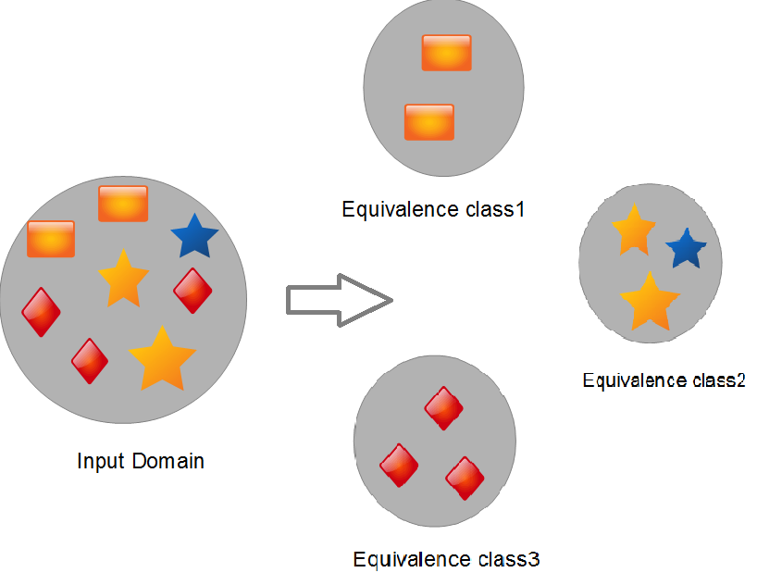
Equivalence Partitioning
If input is valid across range of values
Design test cases from 3 equivalence classes:
Below, within, and above: the range
If input is only valid, if it is a member of a discrete set
Design test cases from 2 equivalence classes:
Valid and invalid: discrete values

Slide 26

Example – Insurance System
Specification Statement
System shall reject over-age insurance applicants.
Specification Item
Reject male applicants over the age of 80 years on day of application.
Reject female applicants over the age of 85 years on day of application.
Input: Gender & Age
Output: accept/reject
Equivalence Classes:
C1: Input: Males over 80
C2: Input: Males 80 or under
C3: Input: Females over 85
C4: Input: Females 85 or under
C5: Output: “accept”
C6: Output: “reject”
Test Cases –
Valid:
TC1: male, 83, reject
TC2: male, 56, accept
TC3: female, 101, reject
TC4: female, 83, accept
Invalid:
TC5: female, -3, ??
TC6: fmale, 14, ??

Slide 27
Activity
public class MyCalendar {
public int getNumDaysInMonth(int month, int year)
throws InvalidMonthException
{ … }
}
Representation for month:
1: January, 2: February, …., 12: December
Representation for year:
1904, … 1999, 2000,…, 2006, …
How many test cases do we need for the black box testing of getNumDaysInMonth()?

Slide 28
Solution: Black box testing of getNumDaysInMonth
Test case | Month | Year
31 day months, non-leap year | 7 | 2001
30 day months, non-leap year | 6 | 2001
February, non-leap year | 2 | 2001
31 day months, leap year | 7 | 2004
30 day months, leap year | 6 | 2004
February, leap year | 2 | 2004
Non-positive invalid month | -1 | 2001
Positive invalid month | 13 | 2001
Valid Discrete Values
Do we have all invalid discrete values?
Invalid Discrete Values
How about: valid month, invalid year?

Slide 29
Static & Dynamic Analysis

Slide 30
Automatic Defect finding?
Source Code
Defect Report
Analysis Algorithm
Automatically find all defects?
Find all defects of a certain well-defined type?
How do we deal with tool imperfections?
Notes:
Automatically find all defects?
Find all defects of a certain well-defined type?
Which type?
Some? All?
False Positives?

Slide 31
Types of Analysis
GOAL: Perform an automated discovery of likely locations of defects.
Static analysis: Code Smells, Bad patterns, Definite Errors
Generally applies simple patterns, ”data flow” analysis, or ”dogma”
Bug Prediction: Bug density, bug distribution
Typically employs Machine learning & Statistics
Dynamic Analysis: Taint Analysis, Performance, Memory
Executes the program, monitors the execution carefully

Slide 32
Selected Code Metrics in Static Analysis
Size: Typically lines of code (LOC) or stories points (SP)
Cyclomatic Complexity:
The number of linearly independent paths that comprise a program
Used to indicate a module’s testability and understandability, based on Control Flow Graph
Object-Oriented Structural Metrics
WMC - Weighted Methods per Class, DIT - Depth of Inheritance Tree, NOC - Number of Children, CBO - Coupling between object classes, and so on.
Technical debt:
The implied cost of additional rework caused by choosing an easy solution now instead of using a better approach that would take longer

Slide 33
Activity
npm install -g sloc
https://www.npmjs.com/package/sloc
-- How many lines of code in your HW4 directory?
Alternative: https://chocolatey.org/packages/CLOC

Slide 34








Statistical Defect Prediction
Historical Defect Data
New Data
Predict
2011
2012
2013
2020

Slide 35
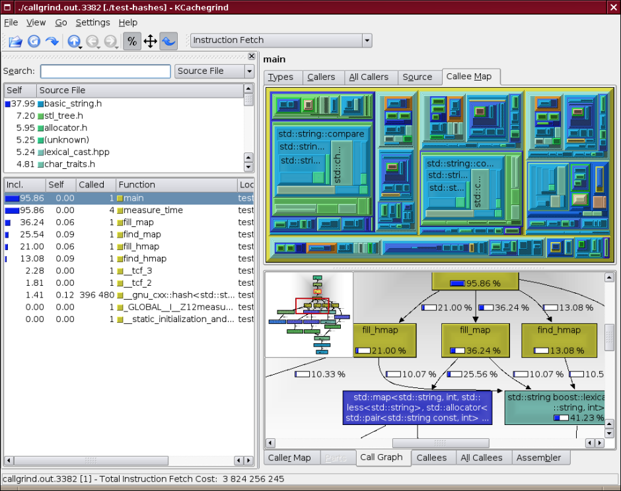
Dynamic Analysis
Valgrind: instrument binaries in order to automatically detect many memory management and threading bugs, and profile your programs in detail.
Coverage
Telemetry
Notes:
Coverage… using instrumentation… probes
Important later for testing...performance...
Other Techniques:
Slicing
Performance, Memory Load
Taint Analysis
Random Testing

Slide 36
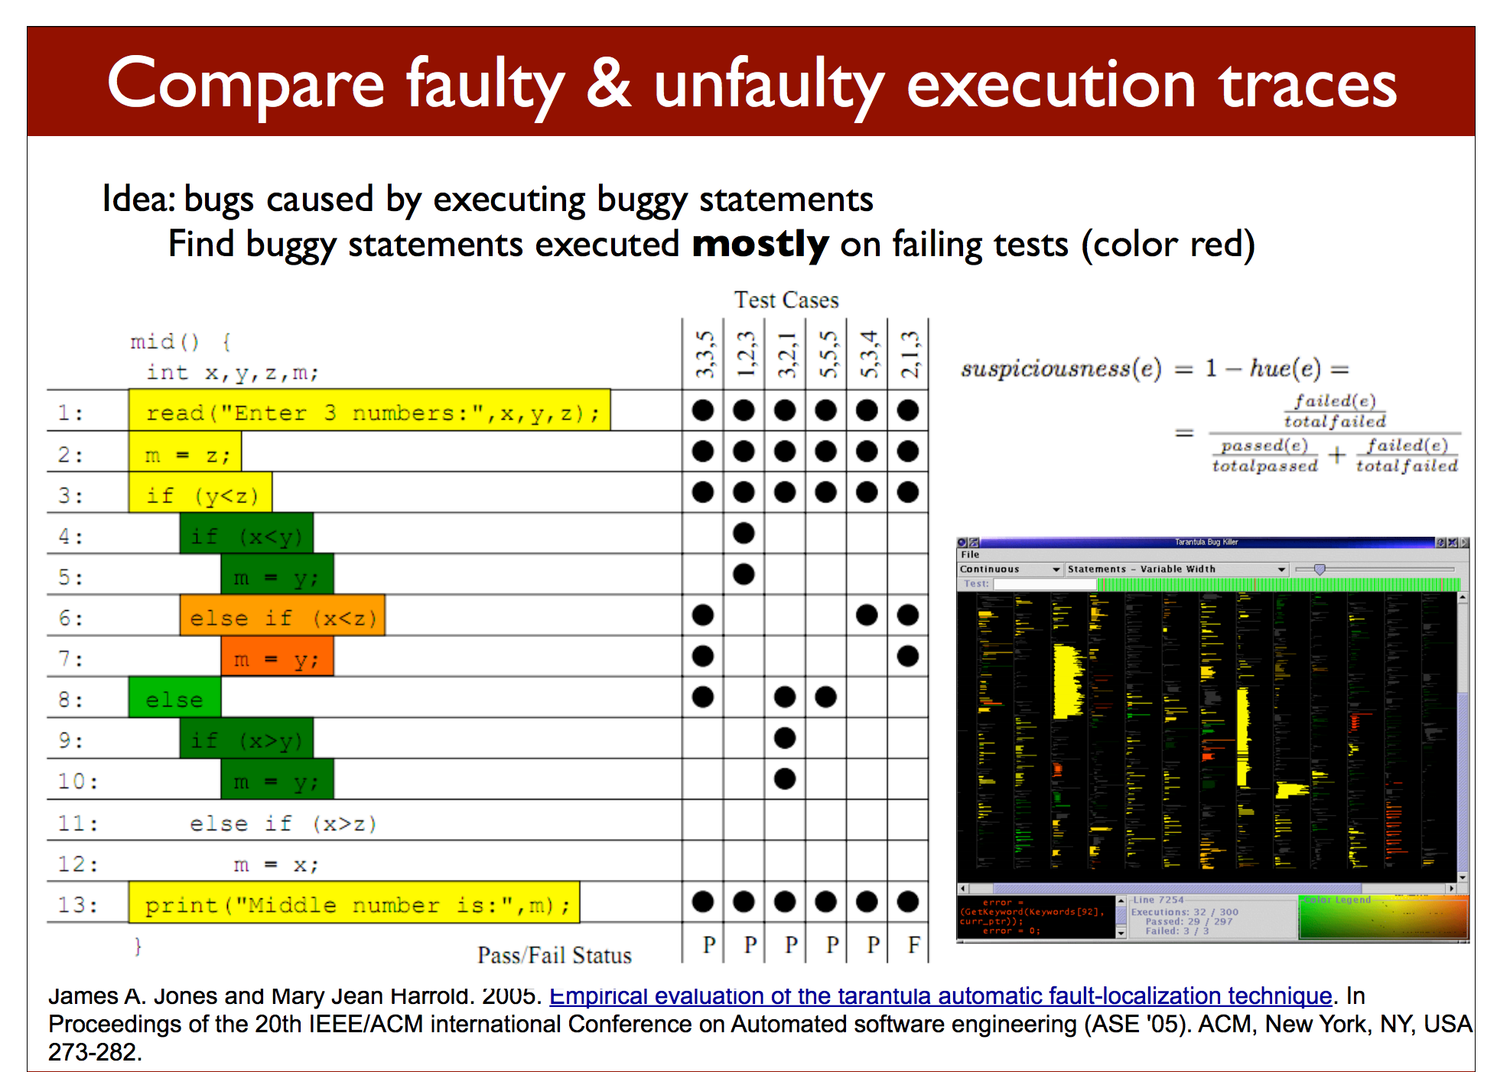
Bug Localization (Hybrid Dynamic/Statistical)
Use statistical properties to calculate the suspiciousness of a line location.

Slide 37
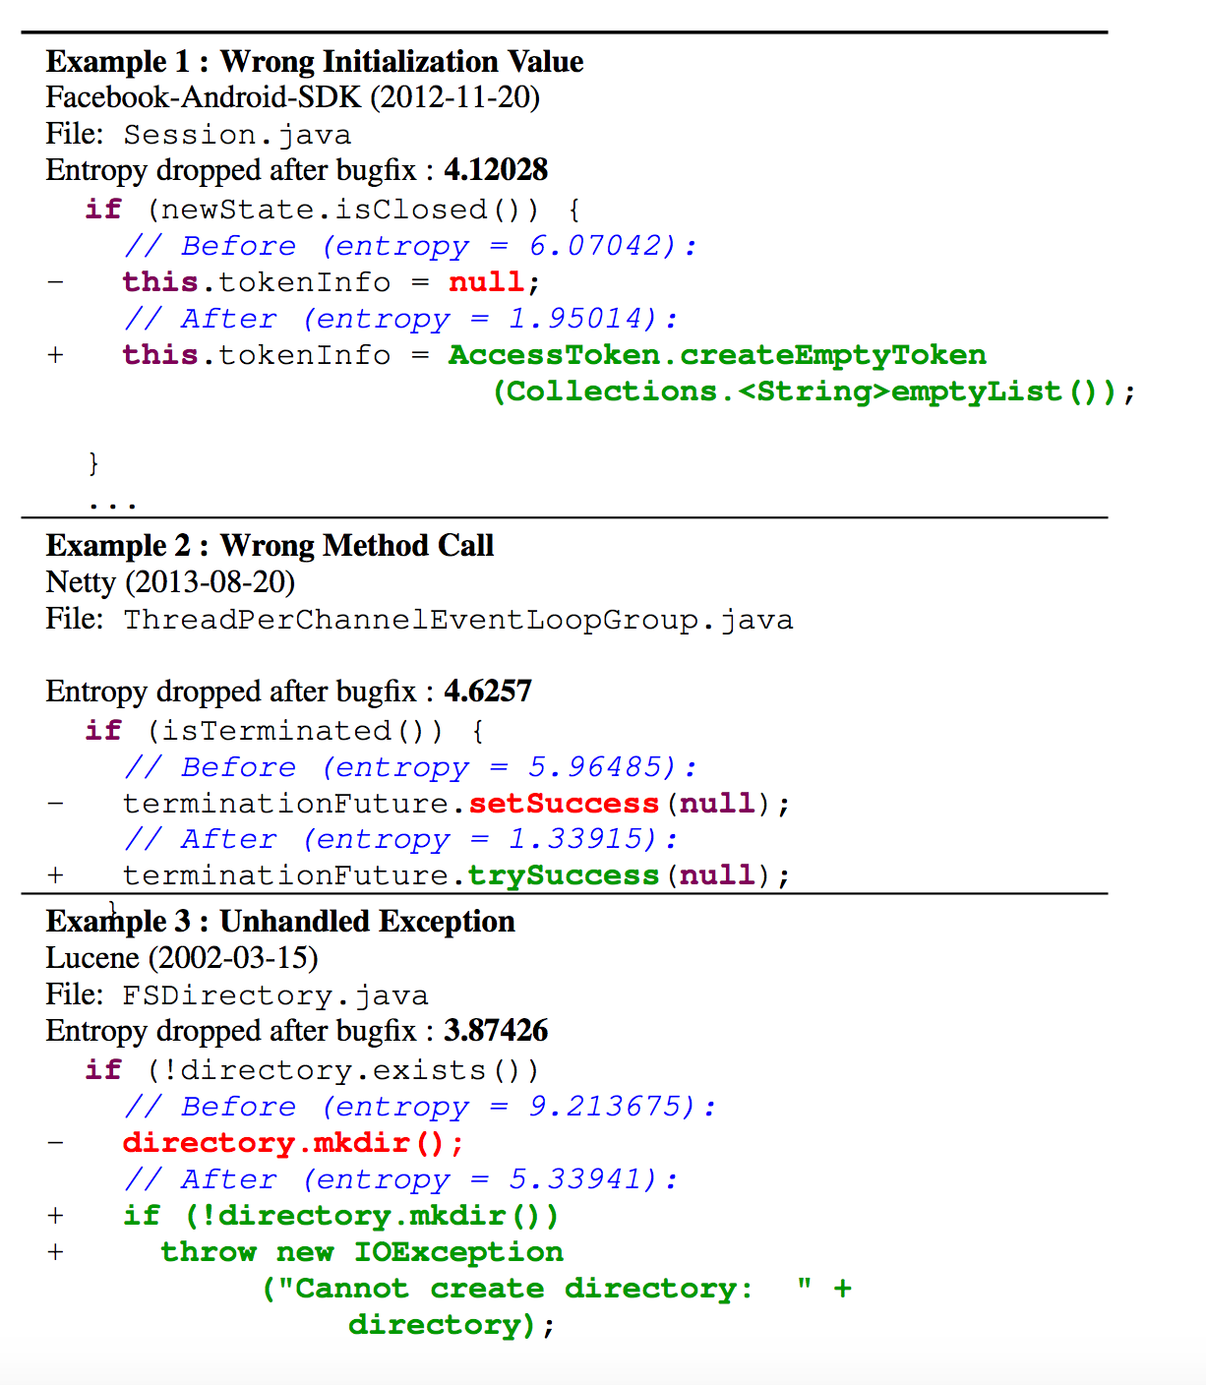
Natural Language Techniques

Slide 38
Bad Smells (usually bad design choices)
Duplicated Code
Why do this? Why not? How to fix?
Long Method
Why have long methods? Why not? How to fix?
God Classes
Worst case: entire application in one class, with hundreds of methods and instance variables.
Why might happen? How to fix?
Notes:
Duplicated code due to perormance concerns, and not undestanding. Old code. Hard to maintain
Long methods to assuage antiquated concerns about efficiency.

Slide 39
Static Analysis Tools
FindBugs: http://findbugs.sourceforge.net/
PMD: https://pmd.github.io/
CheckStyle: https://checkstyle.sourceforge.io/
Jdepend: https://java-source.net/open-source/code-analyzers/jdepend
Ckjm: https://www.spinellis.gr/sw/ckjm/
JavaNCSS: http://www.kclee.de/clemens/java/javancss/
Cobertura: https://cobertura.github.io/cobertura/
Pylint: https://www.pylint.org/
ESLint:
https://marketplace.visualstudio.com/items?itemName=dbaeumer.vscode-eslint

Slide 40
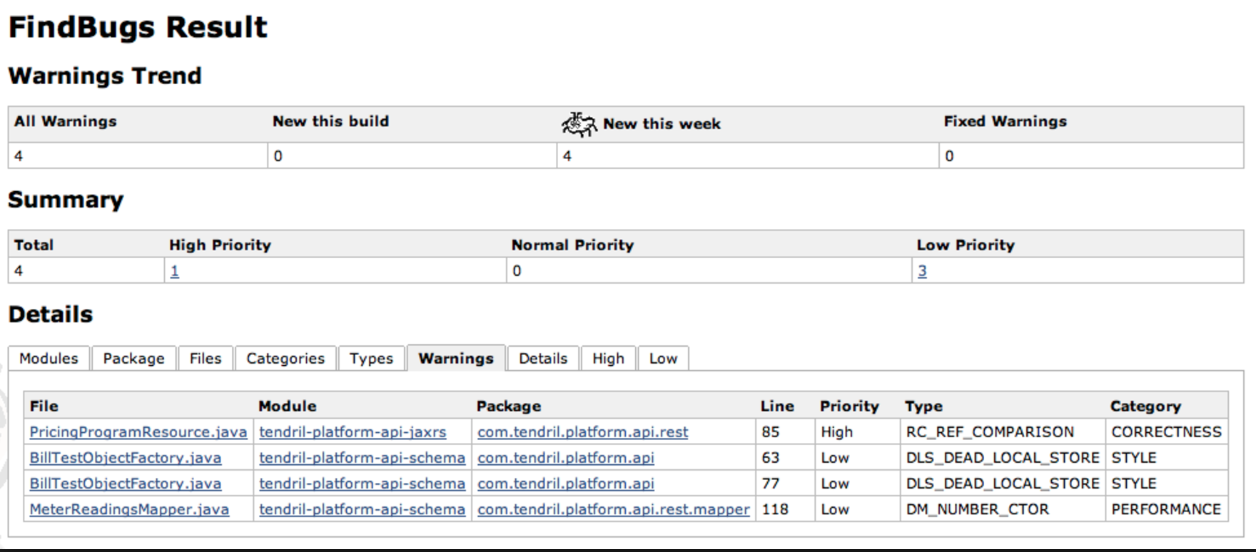
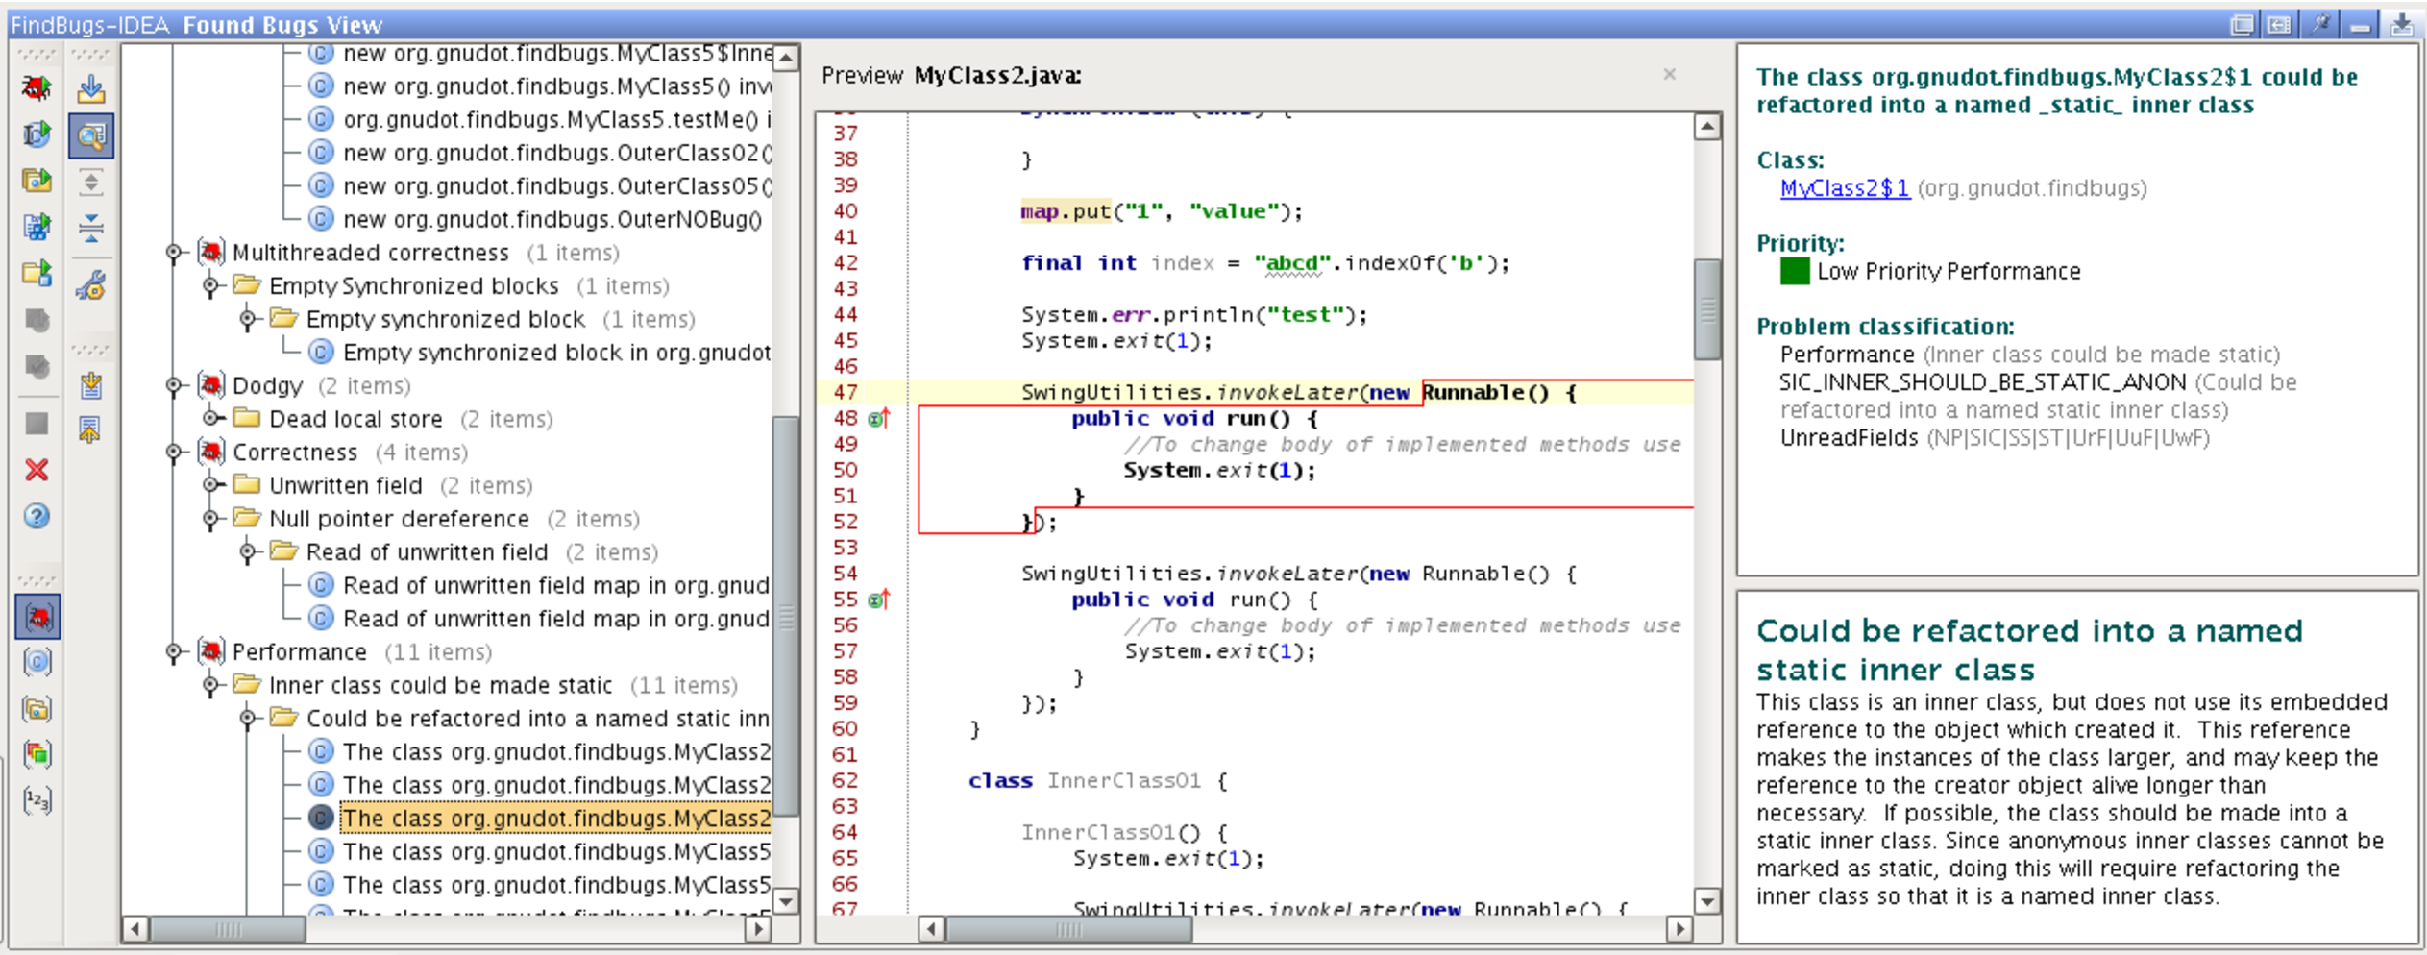

Slide 41
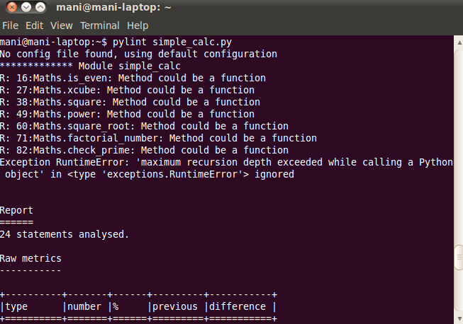
Pylint

Slide 42
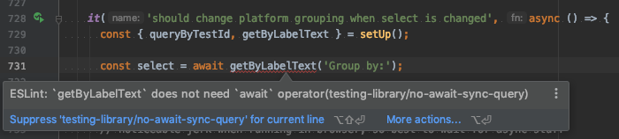
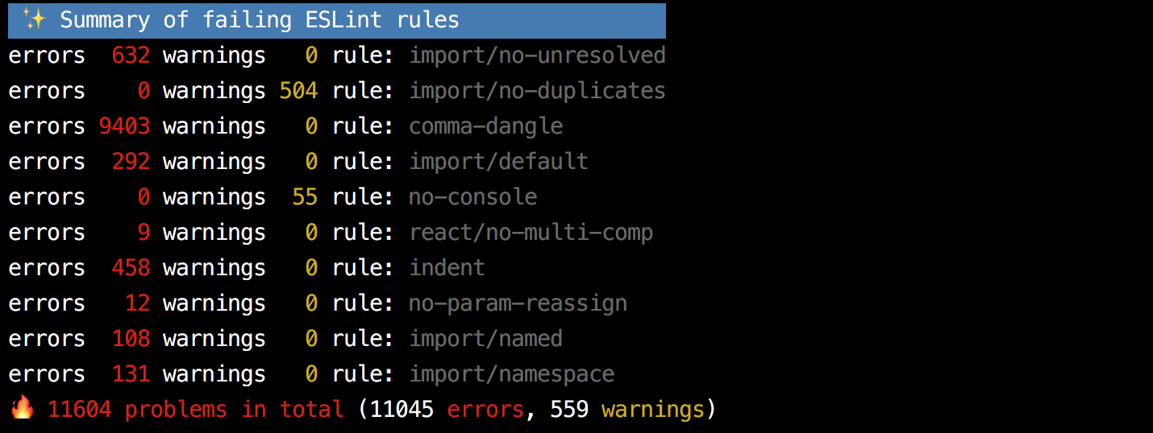
ESLint
ESLint: integrated with VSCode

Slide 43
Reading Assignments
Node.js & JavaScript Testing Best Practices (2020) by Yoni Goldberg:
https://medium.com/@me_37286/yoni-goldberg-javascript-nodejs-testing-best-practices-2b98924c9347
GitHub Standard Fork & Pull Request Workflow
https://gist.github.com/Chaser324/ce0505fbed06b947d962
Youtube video: ESLint Quickstart - find errors automatically
https://www.youtube.com/watch?v=qhuFviJn-es

Slide 44
Code Review
(Thursday 4/8 lecture)

